Slide 1
Naïve Bayes and our daily lives
By Ben Goodwin
11/10/20

Slide 2

Frequentist Approach to Medical Diagnosis
Frequentist Approach to Diagnosis
Some sort of (mental) model which could explain all the causes of the pain
The doctor would then ”probe” and ask the patient questions and use that as feedback into the mental model
These two would then identify the source of pain
Suppose we have a patient visit a doctor for abdominal pain…

Slide 3
Bayesian Approach to Medical Diagnosis
Bayesian Approach to Diagnosis
Some sort of (mental) model which could explain all the causes of the pain
The Bayesian doctor would also have a medical history of the patient
The doctor would then ”probe” and ask the patient questions and use that as feedback into the mental model along with the prior patient history to from a diagnosis
Suppose we have a patient visit a doctor for abdominal pain…

Slide 4
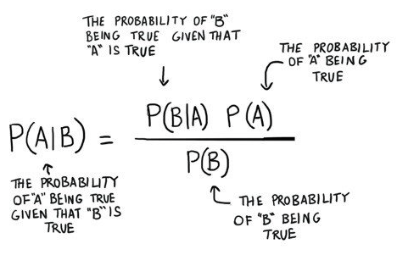
A Brief Introduction to Bayesian Inference versus Frequentist Inference
Bayesian Inference
Uses probabilities for both hypothesis and data
Depends on the prior and likelihood of observed data
Requires one to know or construct a “subjective prior”
Very computationally heavy, and requires integration over many parameters
Frequentist Inference
Never uses or gives the probability of a hypothesis
Depends on the likelihood for observed and unobserved data
Does not require a prior
Less computationally intensive
“Traditional” interpretations of items like p-values and CI’s

Slide 5
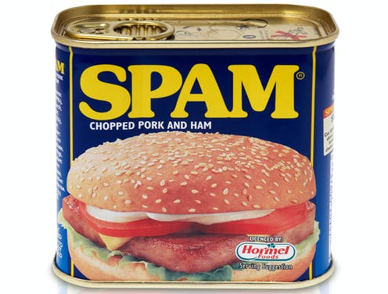
Applications of Bayesian Inference
Naïve Bayes Spam Filtering
A robust and powerful way to sort between the spam and the ham
Roughly 161 billion spam emails sent daily
About 55% of all email is spam
(Used to be as high as 80%)
Naïve Bayes spam filtering can help
Considered a probabilistic classifier and can predict, given an observation of an input, a probability distribution over a set of classes

Slide 6
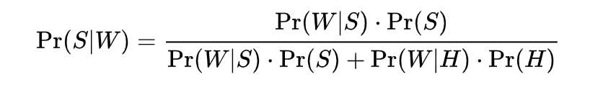
Naïve Bayes Spam Filtering
Process for spam detection:
Certain words have higher instances of being included in illegitimate emails (Viagra, replica, Meet singles)
Modern email systems have previously had humans classify emails as spam or ham for training purposes
The filter will adjust the probabilities that each word will appear in spam or legitimate email in its database
After training, the word probabilities (likelihood functions) are used to compute the probability that an email with a particular set of words in it belongs to either category.
Each word in the email contributes to the email's spam probability, or only the most interesting words.
This contribution is called the posterior probability and is computed using Bayes’ Theorem
Then, the email's spam probability is computed over all words in the email, and if the total exceeds a certain threshold (say 95%), the filter will mark the email as a spam.
the probability that a message is a spam, knowing that a “spam” word is in it;

Slide 7
Works Cited
https://www.statista.com/statistics/420391/spam-email-traffic-share/
https://ocw.mit.edu/courses/mathematics/18-05-introduction-to-probability-and-statistics-spring-2014/readings/MIT18_05S14_Reading20.pdf

